Slide 1
Multiplex Booking System

Slide 2
Team Members
1 Raj Aryan Mishra
2 Sanchit Banga
3 Garvit Shubham
4 Tushar Tyagi

Slide 3
Understanding the problems
01
Traditional Methods of ticket booking are time-consuming and convenient
02
A Multiplex Booking system offers hassle free and convenient experience, allowing users to book tickets anywhere
03
Choosing a reliable and efficient booking system is crucial for multiplexes to provide a seamless user experience and stay competitive in the market

Slide 4
Project objective
To provide a multiplex ticket booking system where
Users can see the show details
Users can book and cancel tickets for movies
Administrators(Multiplex employee) can publish show details
Administrators can generate earning reports

Slide 5
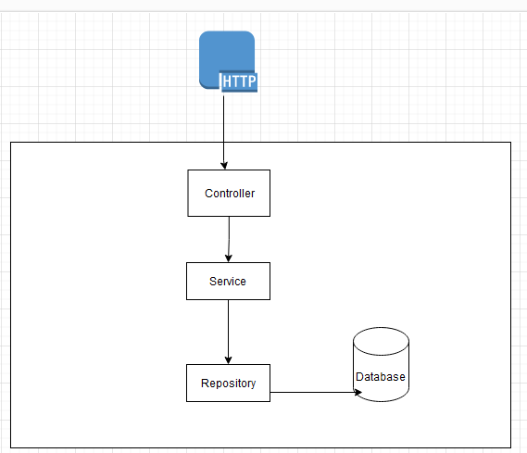
Request Response

Slide 6
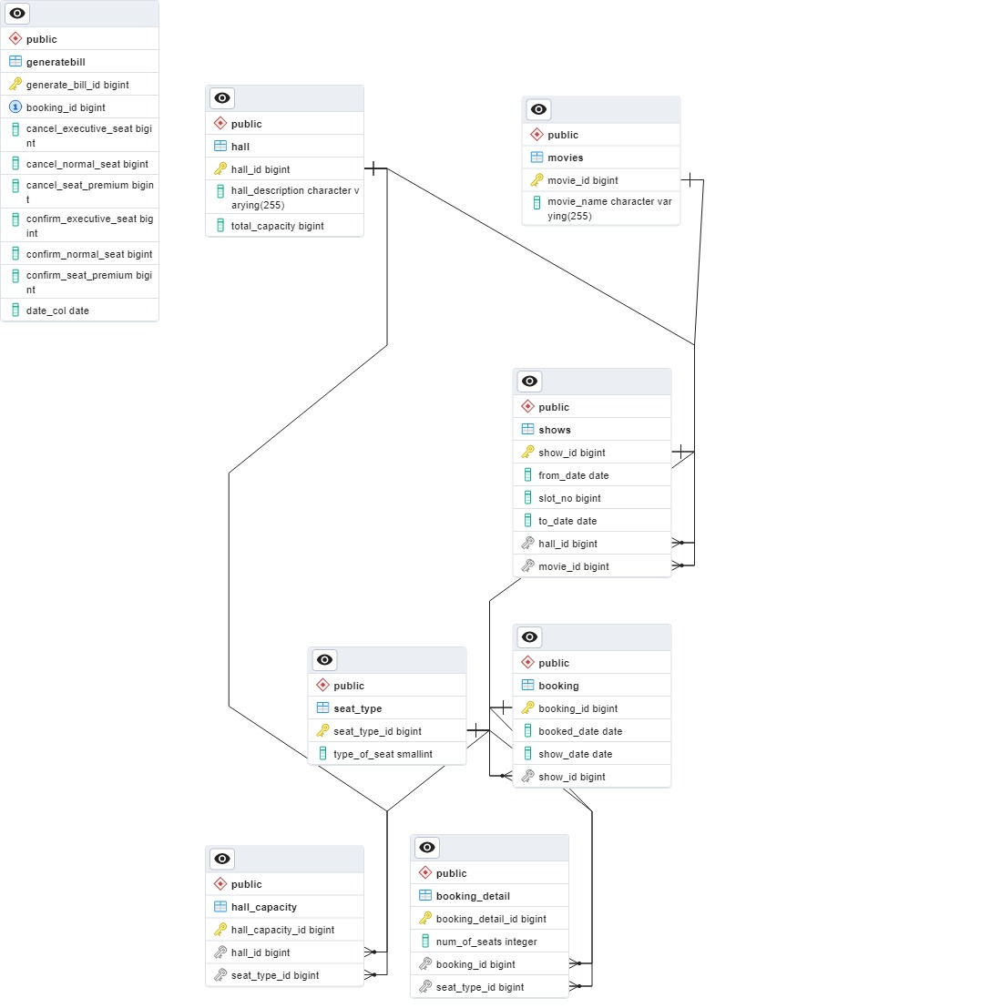
DB Schema/ER

Slide 7







Tech Stack

Slide 8
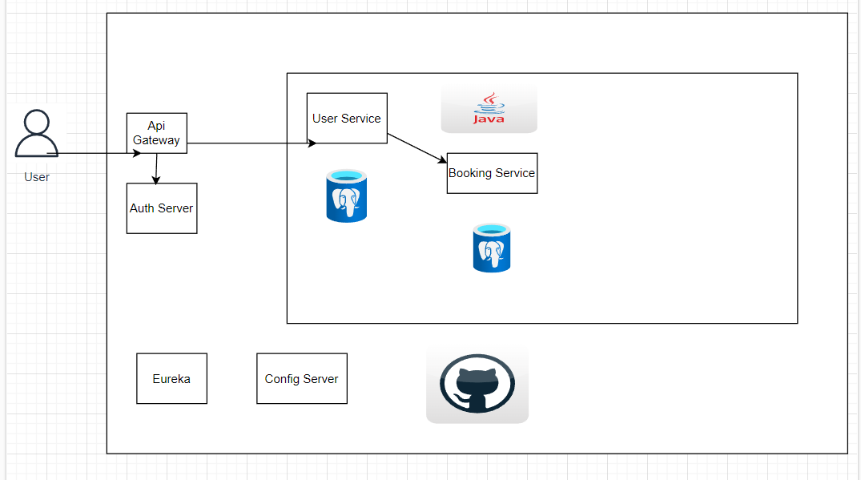

System Architecture

Slide 9
Future Scope
With every booking send a ticket in a mail
A sms reminder for user bookings
Particular seat Id for each user
Payment microservice

Slide 10
Thank you!

